Slide 1

Machine Learning
Haydé Martínez
@haydemtzl

Slide 2





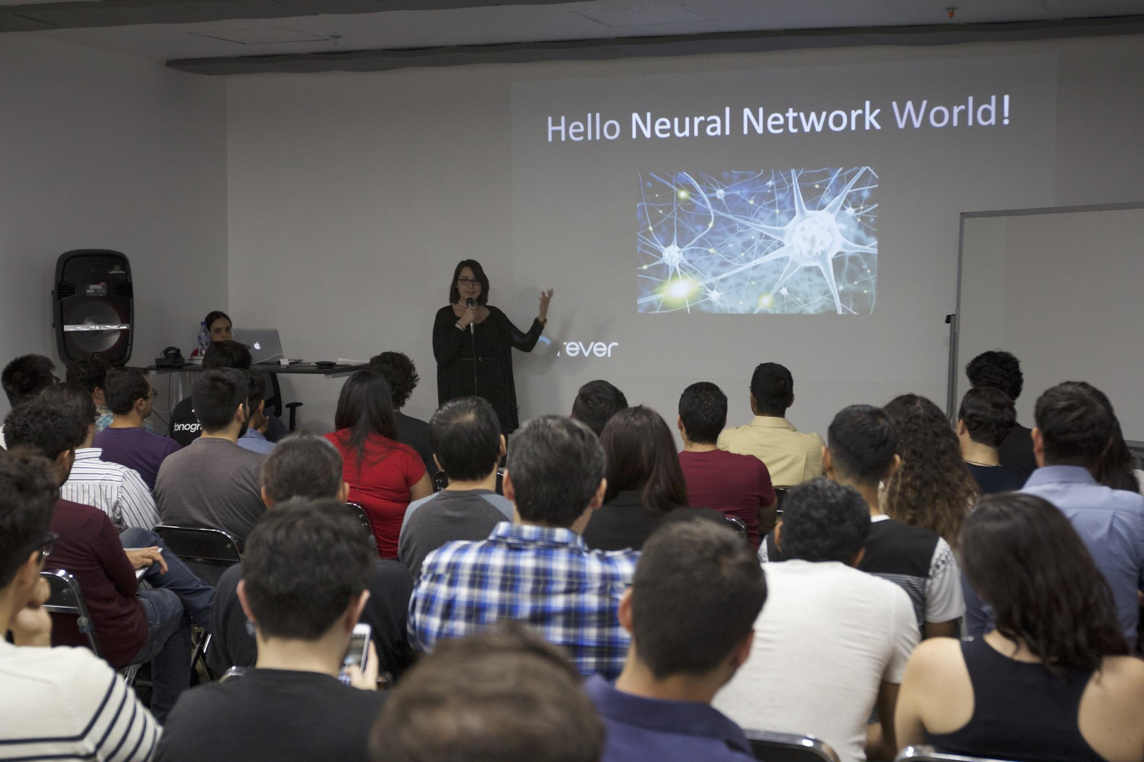
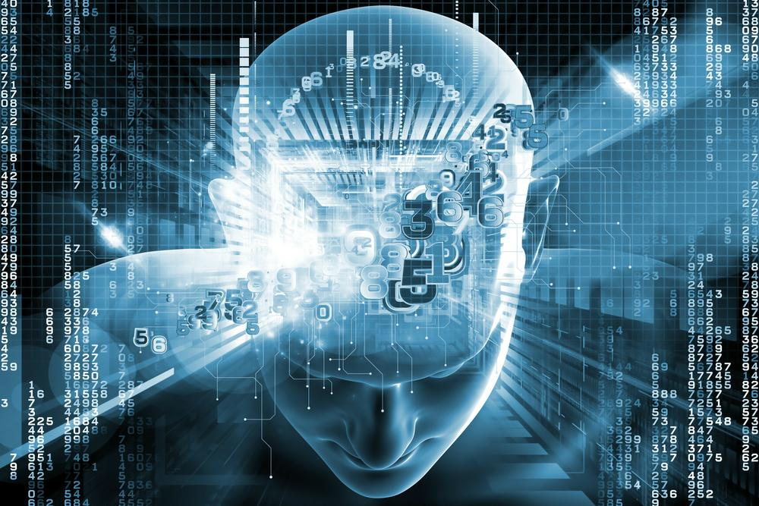

Slide 3
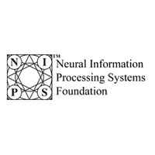
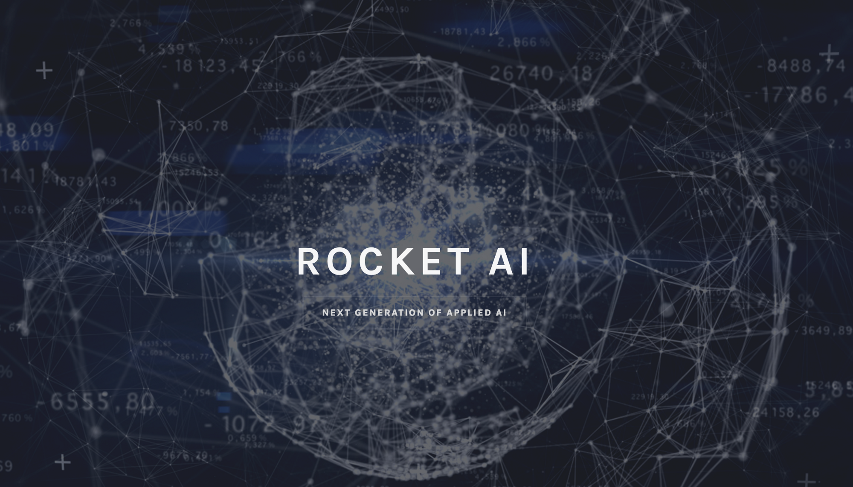
Temporally Recurrent Optimal Learning

Slide 4
TROL(L)

Slide 5
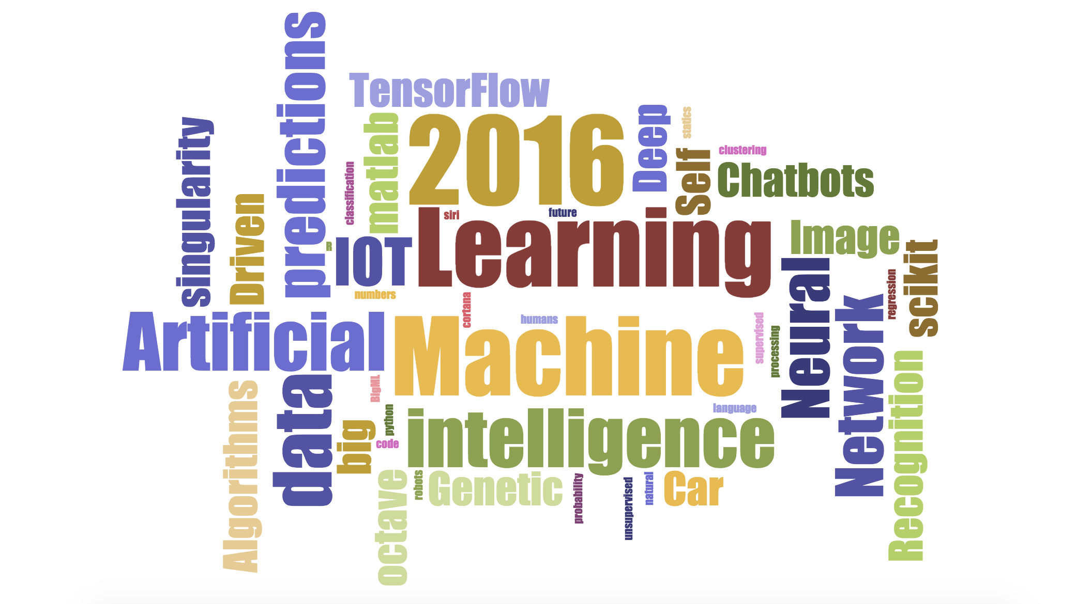
Notes:
Temporally Recurrent Optimal Learning - Neural Information Processing Systems

Slide 6
Artificial Intelligence

Slide 7

Notes:
This is Samantha, she is the personal assistant for Theodore. She sorts his mail, set ups meetings, and orders groceries. She paints and writes poetry. She is the best friend. And she is also an artificial intelligence from the movie “Her”. Just imagine her as the evolution of Siri.
We’ve all heard about AI, Machine Learning, deep learning, neural networks and natural language processing. It’s time to get to understand the basic concepts of it, and how they’re interconnected.

Slide 8
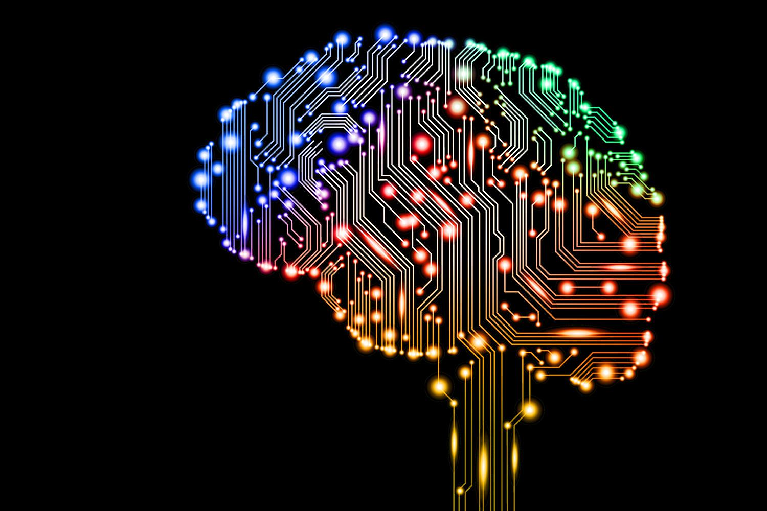
Notes:
It’s an attempt to make computers smart, or even smarter than human-beings.
It’s about giving computers human-like behaviours, thought process and reasoning abilities.

Slide 9
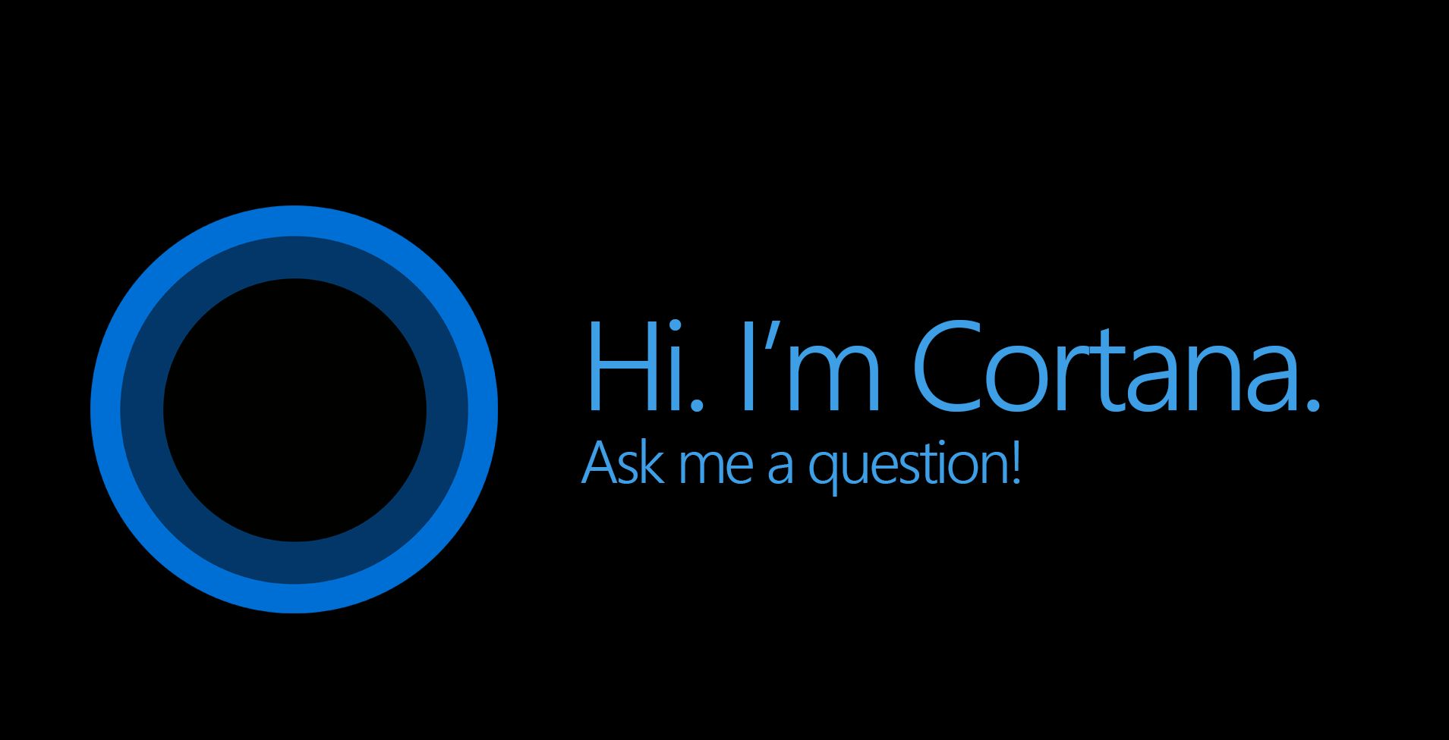
Notes:
That’s the AI that is focused on a narrow task. Siri and Cortana are great examples of this AI, they are giving us the weather, but they have limits.
Siri can’t read and delete your unimportant emails.It can’t go beyond its original programming.

Slide 10
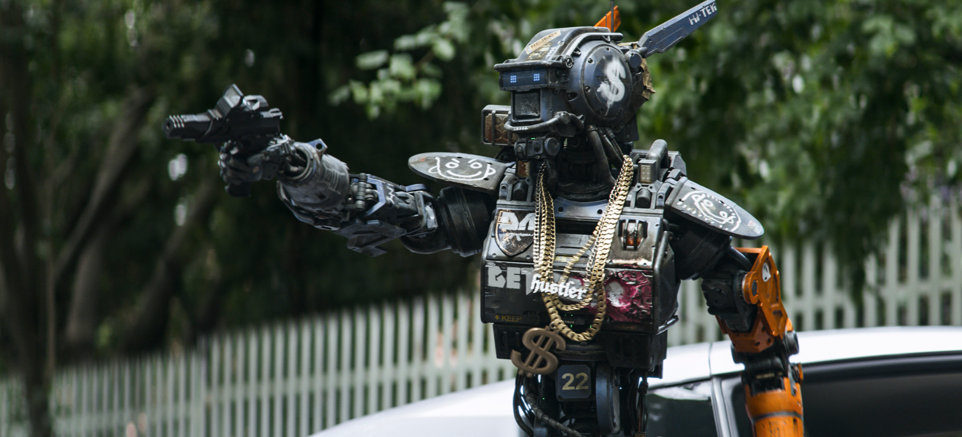
Notes:
Strong or General AI
This is what we have seen in science fiction.
Samantha is the very definition of strong AI. She can learn new things and modify her own code base.
She can beat you in chess and drive a car.

Slide 11
The Anatomy of AI

Slide 12
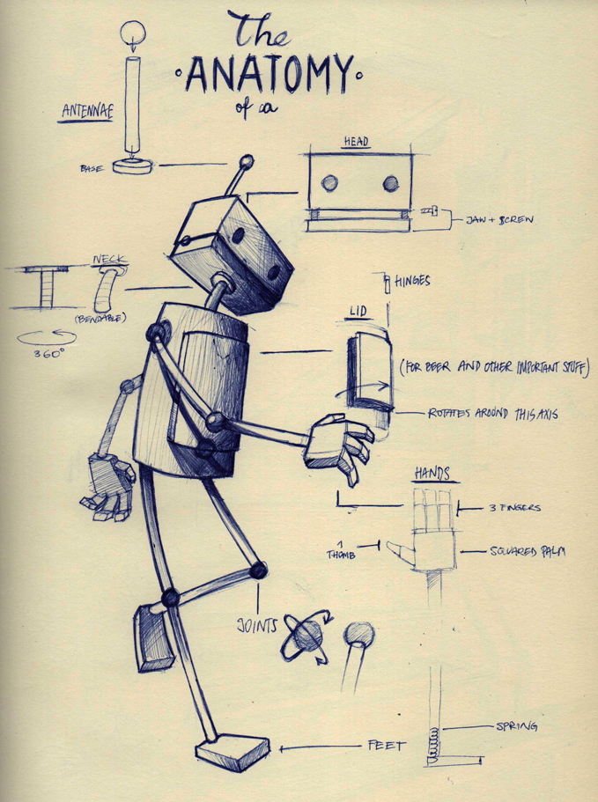
Notes:
Perception
Natural Language Processing
Knowledge Representation
Reasoning
Planning and Navigation

Slide 13
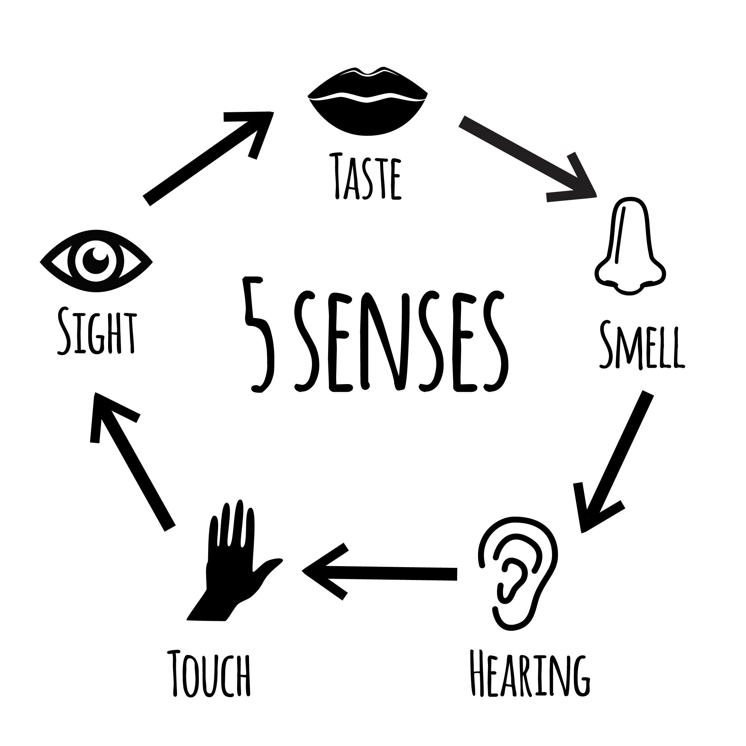
Notes:
Computers needs senses in order to perceive, and can have more than human’s five, like X-ray vision or Sonar detection.

Slide 14
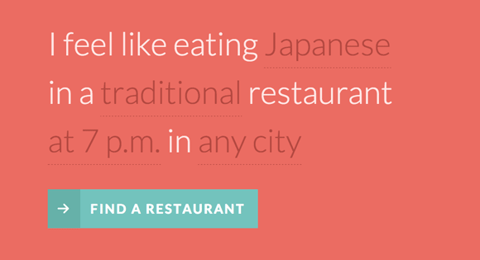
Notes:
That’s a hard task for computers in both spoken and written language, given how the same sentence can have different meanings depending on the context.

Slide 15
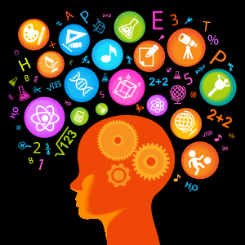

Slide 16
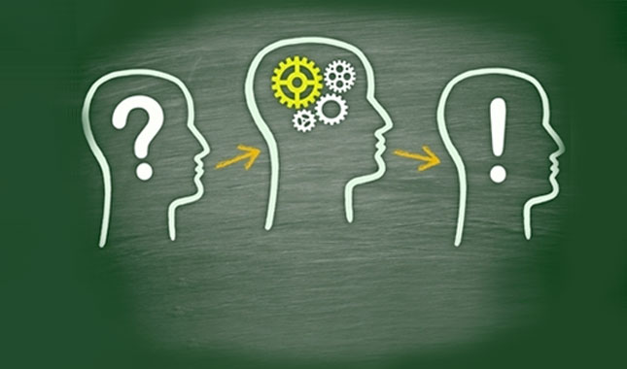

Slide 17
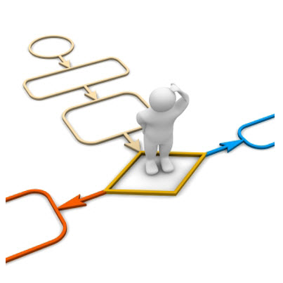

Slide 18
Machine Learning

Slide 19
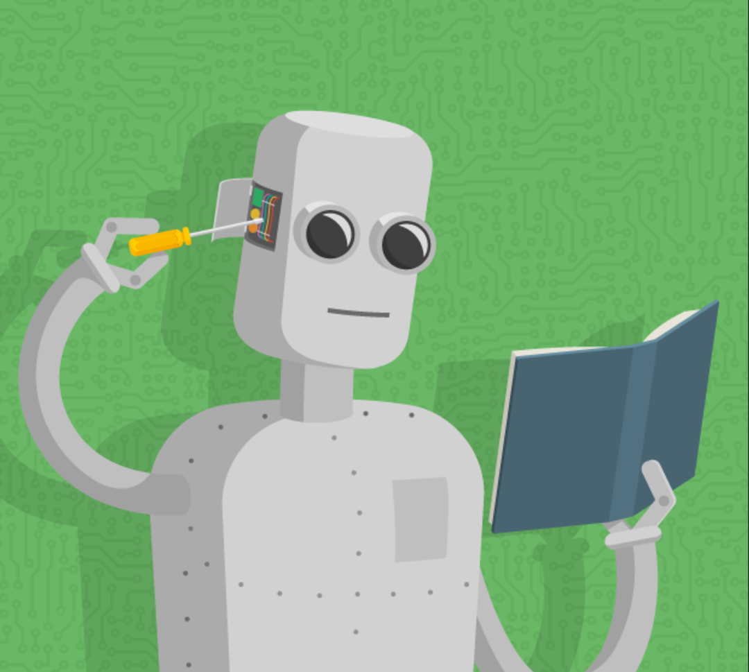
Notes:
That’s an AI technique concerned with learning insights from data and using them to make predictions about the world.
Machine learning is a set of algorithms used to make a system “artificially intelligent,” enabling it to recognize patterns from large datasets and apply the findings to new data.
Machine Learning is done with Algorithms.

Slide 20

Notes:
This kind of learning is when you guide the Algorithm to the right answer by providing examples.

Slide 21
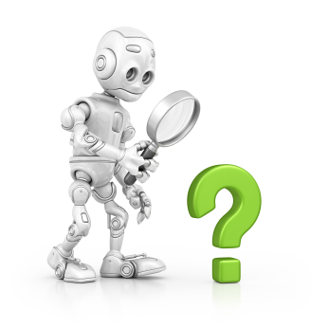
Notes:
This kind of learning is when you let the algorithm find the right answer categorizing the data. No examples of right answers are provided.

Slide 22
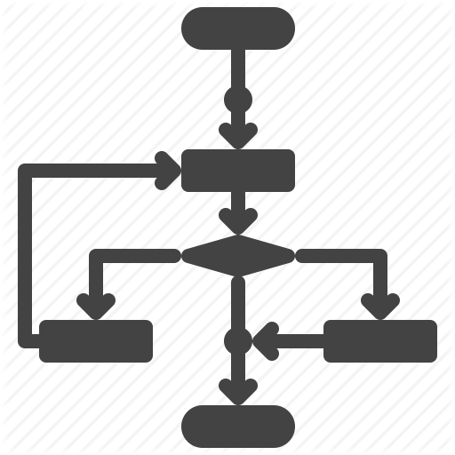

Slide 23
Neural Networks

Slide 24
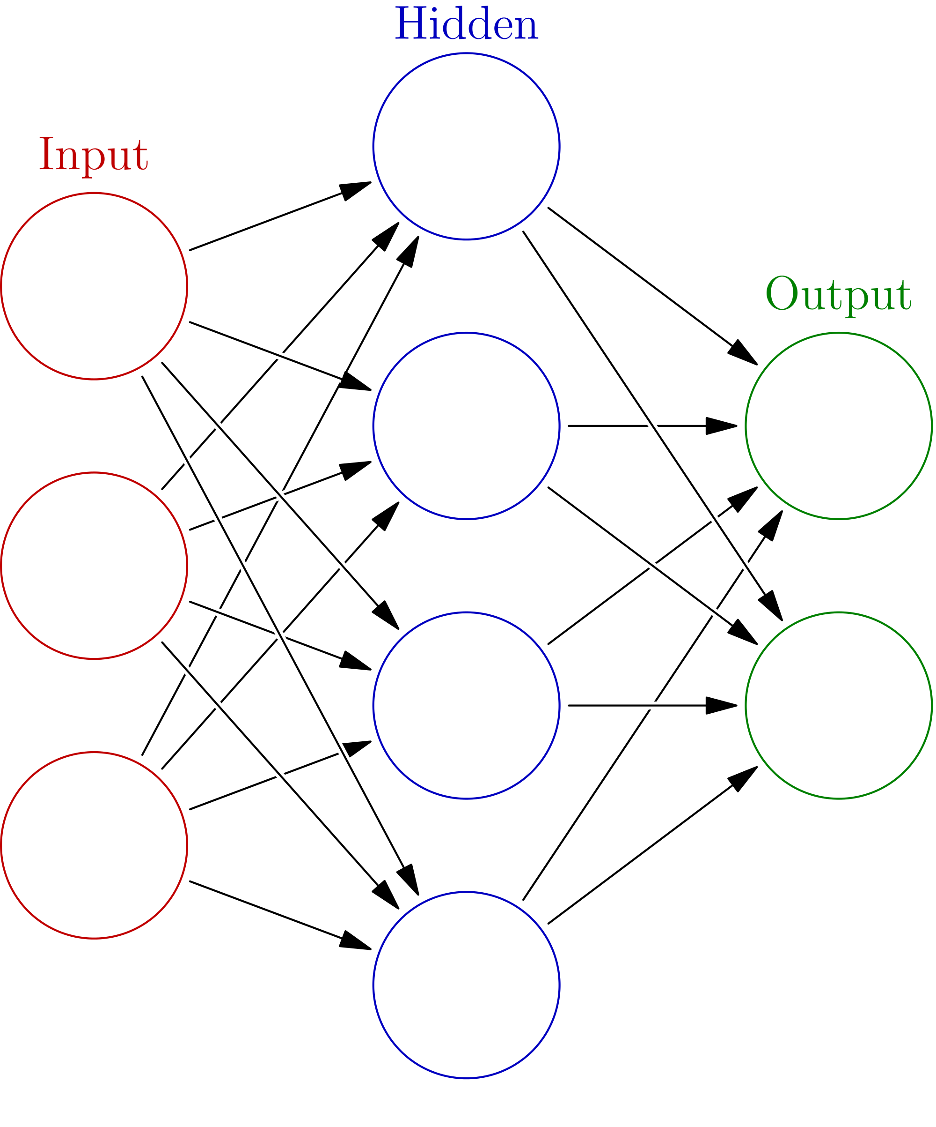

Slide 25
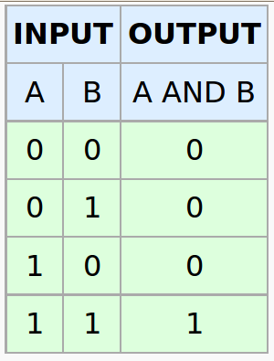

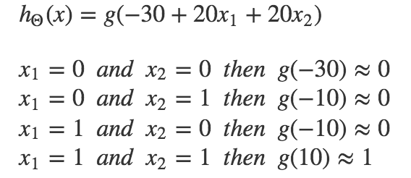
Notes:
AND Gate

Slide 26
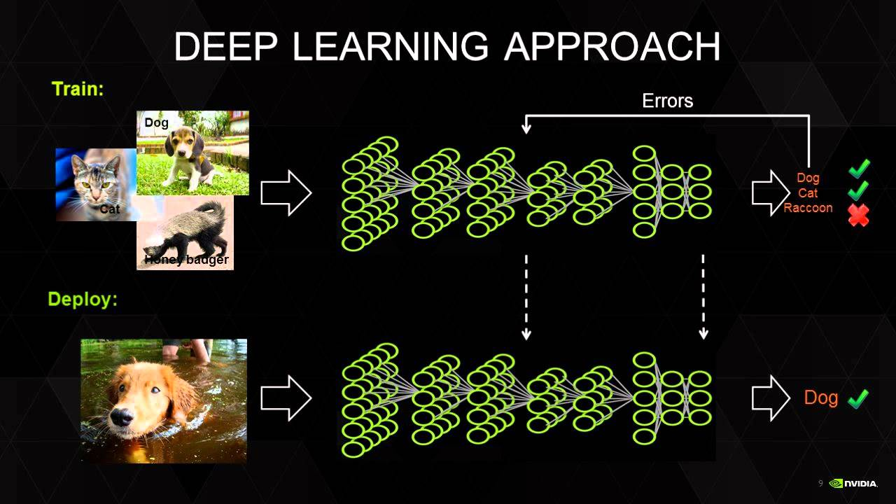

Slide 27
General or Strong AI
Supervised Learning
Artificial Intelligence (AI)
Narrow or Weak AI
Machine Learning
Artificial Neural Networks
Algorithms
Unsupervised Learning
Deep Learning
Notes:
This is a general diagram of the Interrelation all this terms have.

Slide 28
What are companies using ML for?

Slide 29



Notes:
Google has built their system around search data and ad clicks.
Facebook their newsfeed and social interaction data.
Amazon their product purchasing and recommendation data.

Slide 30


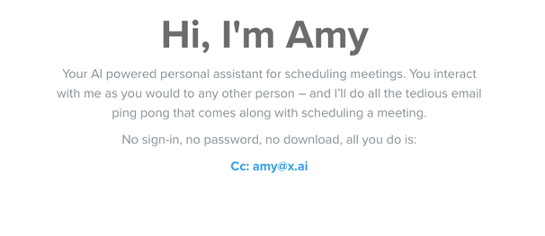

Slide 31
Applying Machine Learning

Slide 32
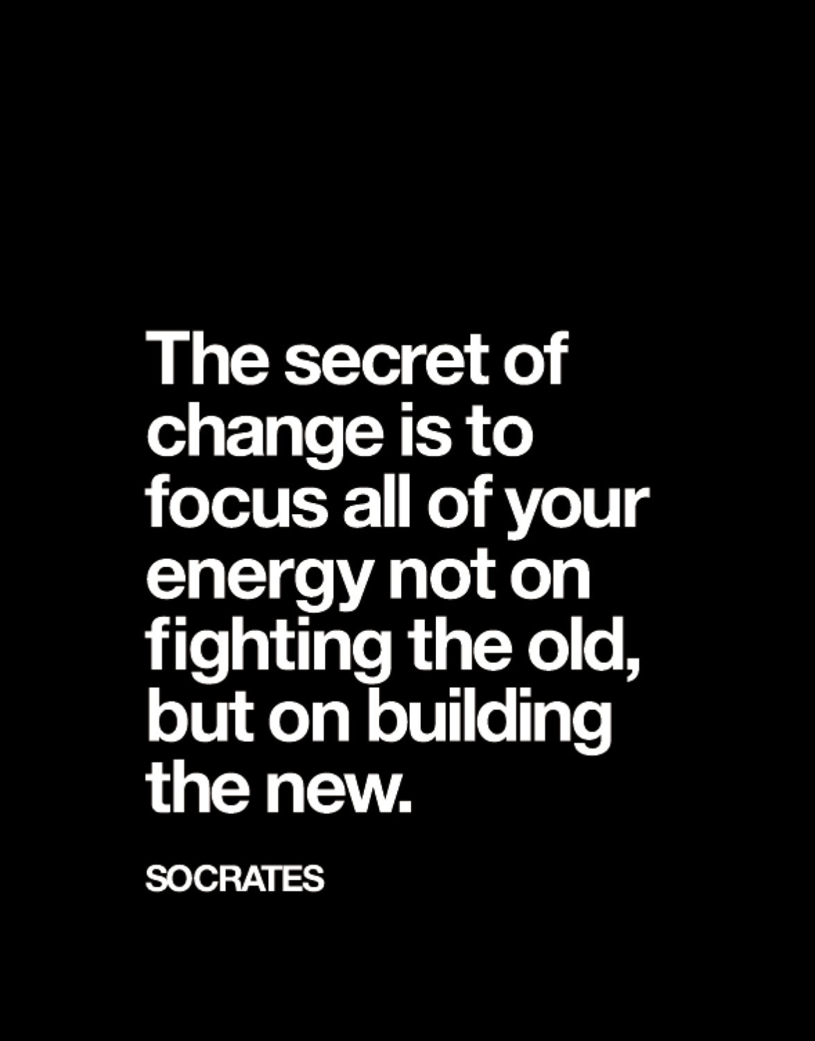

Slide 33

Notes:
It’s better to have the best data to solve a specific problem or to be playing a different game. We feed data for training machine learning models that can create powerful network effects at scale.

Slide 34
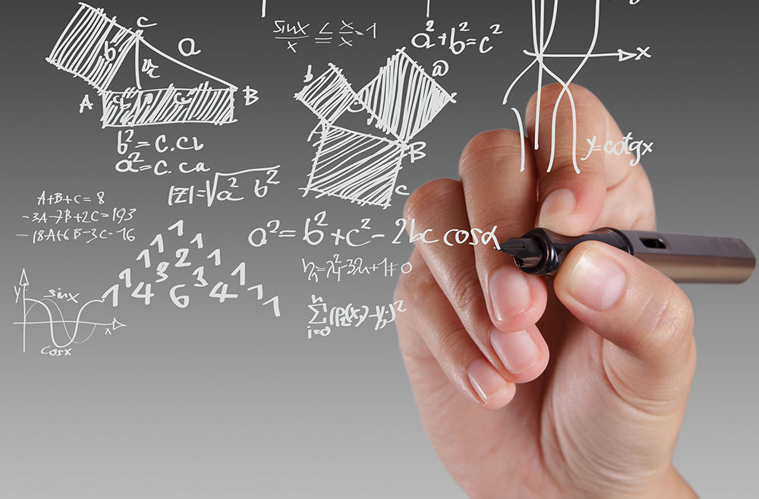

Slide 35
Notes:
Google has built their system around search data and ad clicks.
Facebook their newsfeed and social interaction data.
Amazon their product purchasing and recommendation data.

Slide 36


Slide 37
What separates a successful applied machine learning company is often the novelty, quality and/or quantity of the data they have access to.

Slide 38
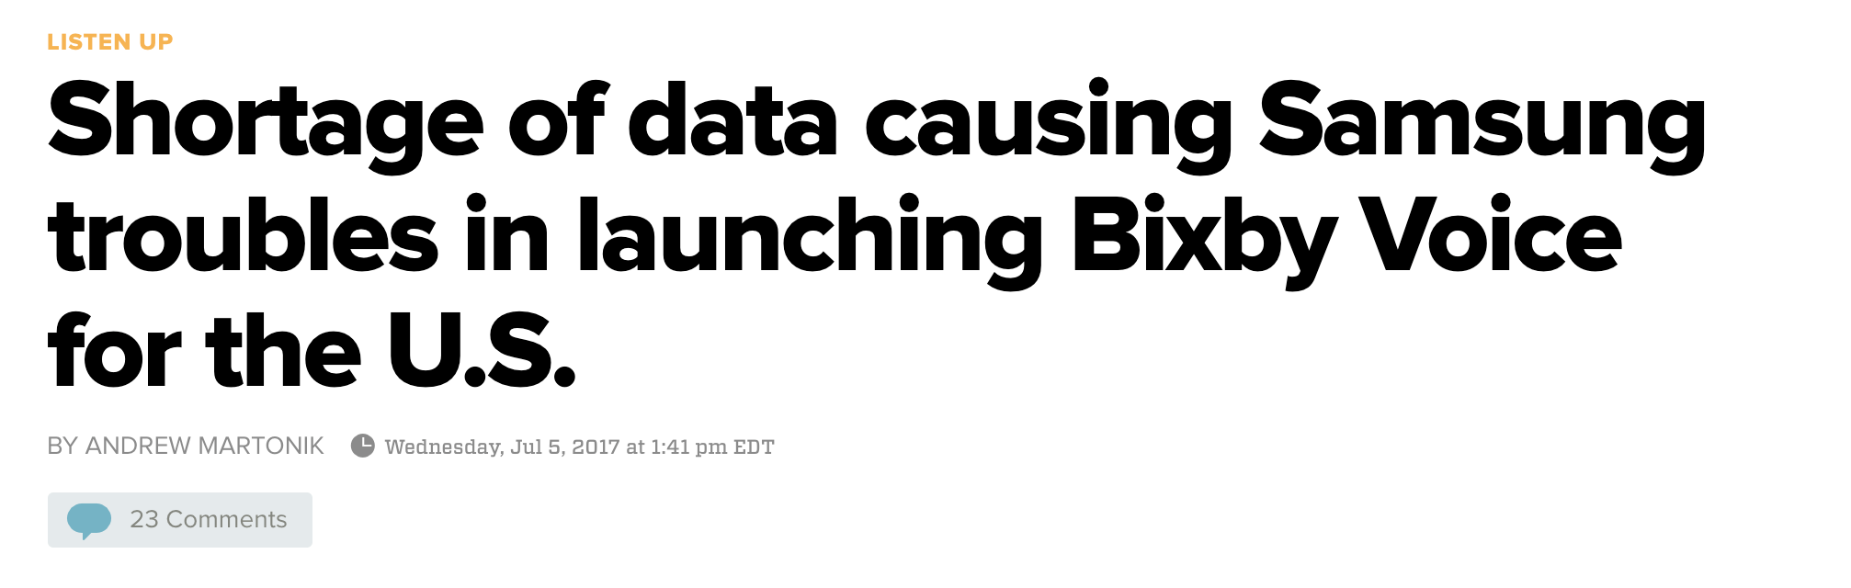
“The delay comes from a handful of issues with the service but is driven by a lack of usage data that's ultimately required for the machine learning systems to work at their full potential”

Slide 39
Rever + AI
What are we doing?

Slide 40
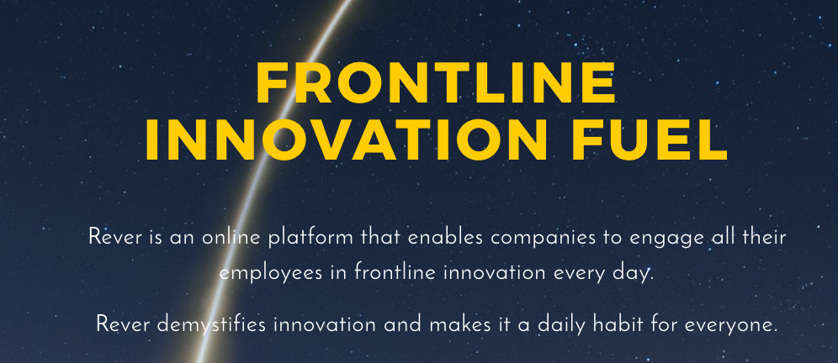



Slide 41
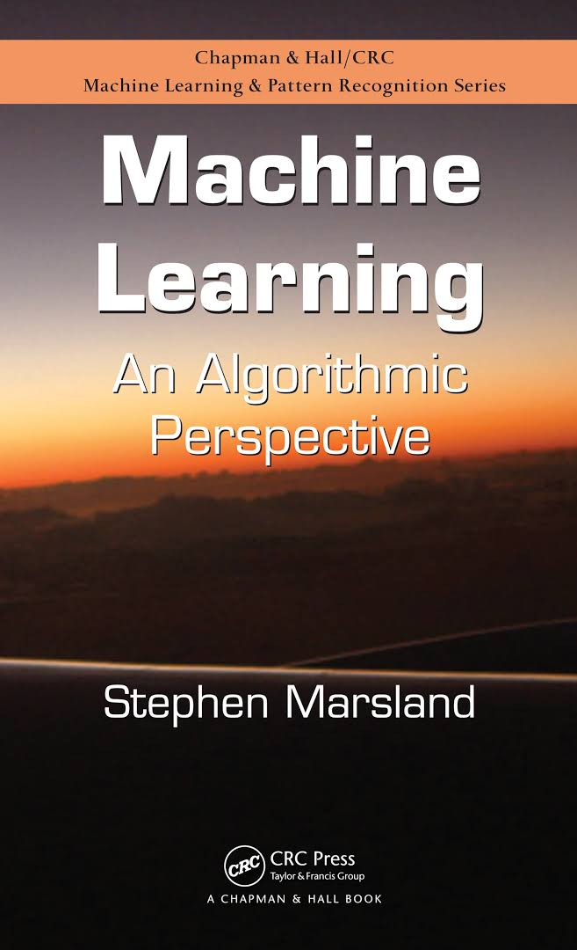
Want to learn more?
Book: Machine Learning An Algorithmic Perspective
By: Stephen Marsland

Slide 42

Want to learn more?
Course: Machine Learning By: Stanford University Hosted by: Coursera
Link: https://www.coursera.org/learn/machine-learning

Slide 43
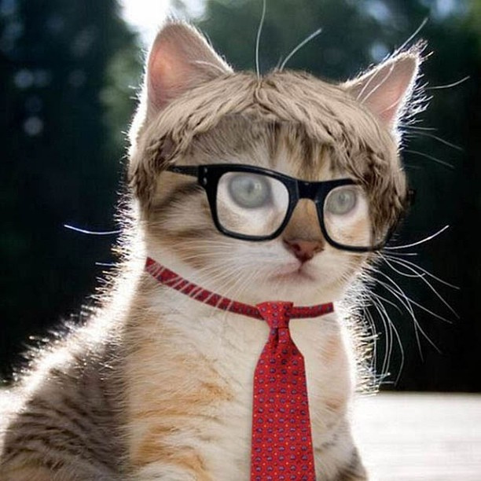
Want to learn more?
Complete this exercise using Python and TensorFlow
https://www.tensorflow.org/get_started/mnist/beginners

Slide 44
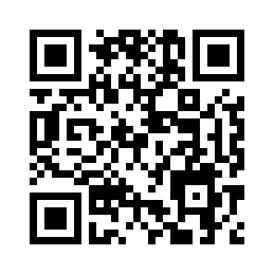
Thanks!
hayde@reverscore.com

